Slide 1
Optimising the acute care pathway using operational research techniques
Tom Knight
Academic Clinical Lecturer
ST7 AIM/GIM
Notes:
• Welcome and Objectives:
• Explain the purpose: to enhance understanding of observational study designs, diagnostic accuracy, and risk prediction models.
• Outline key takeaways: how to critically appraise studies and apply evidence in clinical practice.
• Why it Matters:
• The role of observational studies in generating real-world evidence.
• Importance in informing clinical decision-making without the constraints of randomized controlled trials (RCTs).

Slide 2
Professional Background
Senior trainee in acute medicine / general medicine
PhD from the University of Birmingham
Interest in the use of routinely collected data to optimise acute care processes
Currently employed by Acute Medicine at Wythenshawe
Funded lecturers post at UoM (split my time 50:50)
Co-supervised (Tim Felton / Anthony Wilson)
Notes:
• Welcome and Objectives:
• Explain the purpose: to enhance understanding of observational study designs, diagnostic accuracy, and risk prediction models.
• Outline key takeaways: how to critically appraise studies and apply evidence in clinical practice.
• Why it Matters:
• The role of observational studies in generating real-world evidence.
• Importance in informing clinical decision-making without the constraints of randomized controlled trials (RCTs).

Slide 3
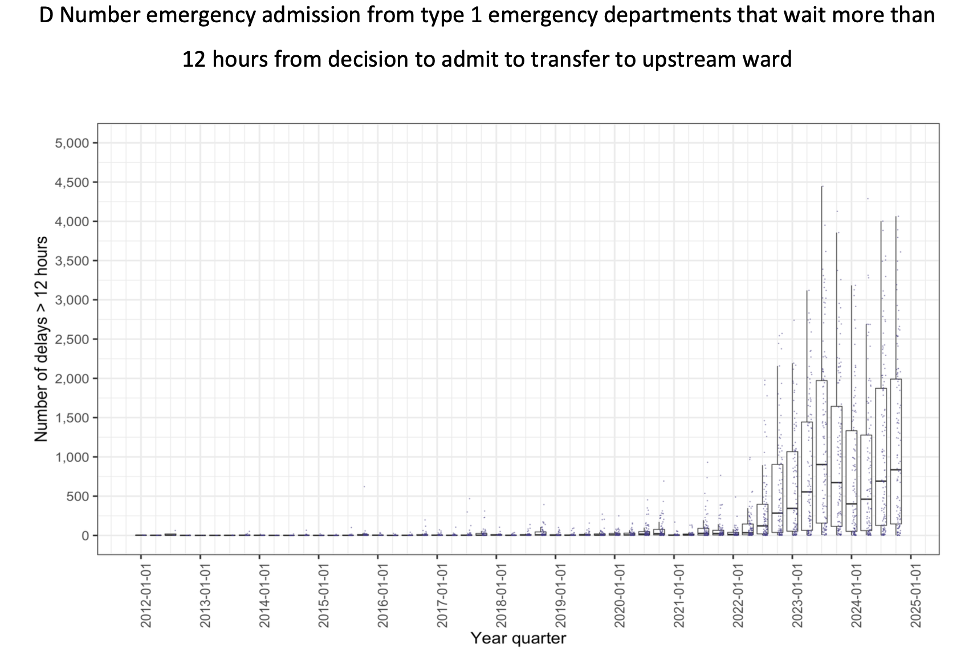
Medical Outliers in ED
Notes:
• Welcome and Objectives:
• Explain the purpose: to enhance understanding of observational study designs, diagnostic accuracy, and risk prediction models.
• Outline key takeaways: how to critically appraise studies and apply evidence in clinical practice.
• Why it Matters:
• The role of observational studies in generating real-world evidence.
• Importance in informing clinical decision-making without the constraints of randomized controlled trials (RCTs).

Slide 4
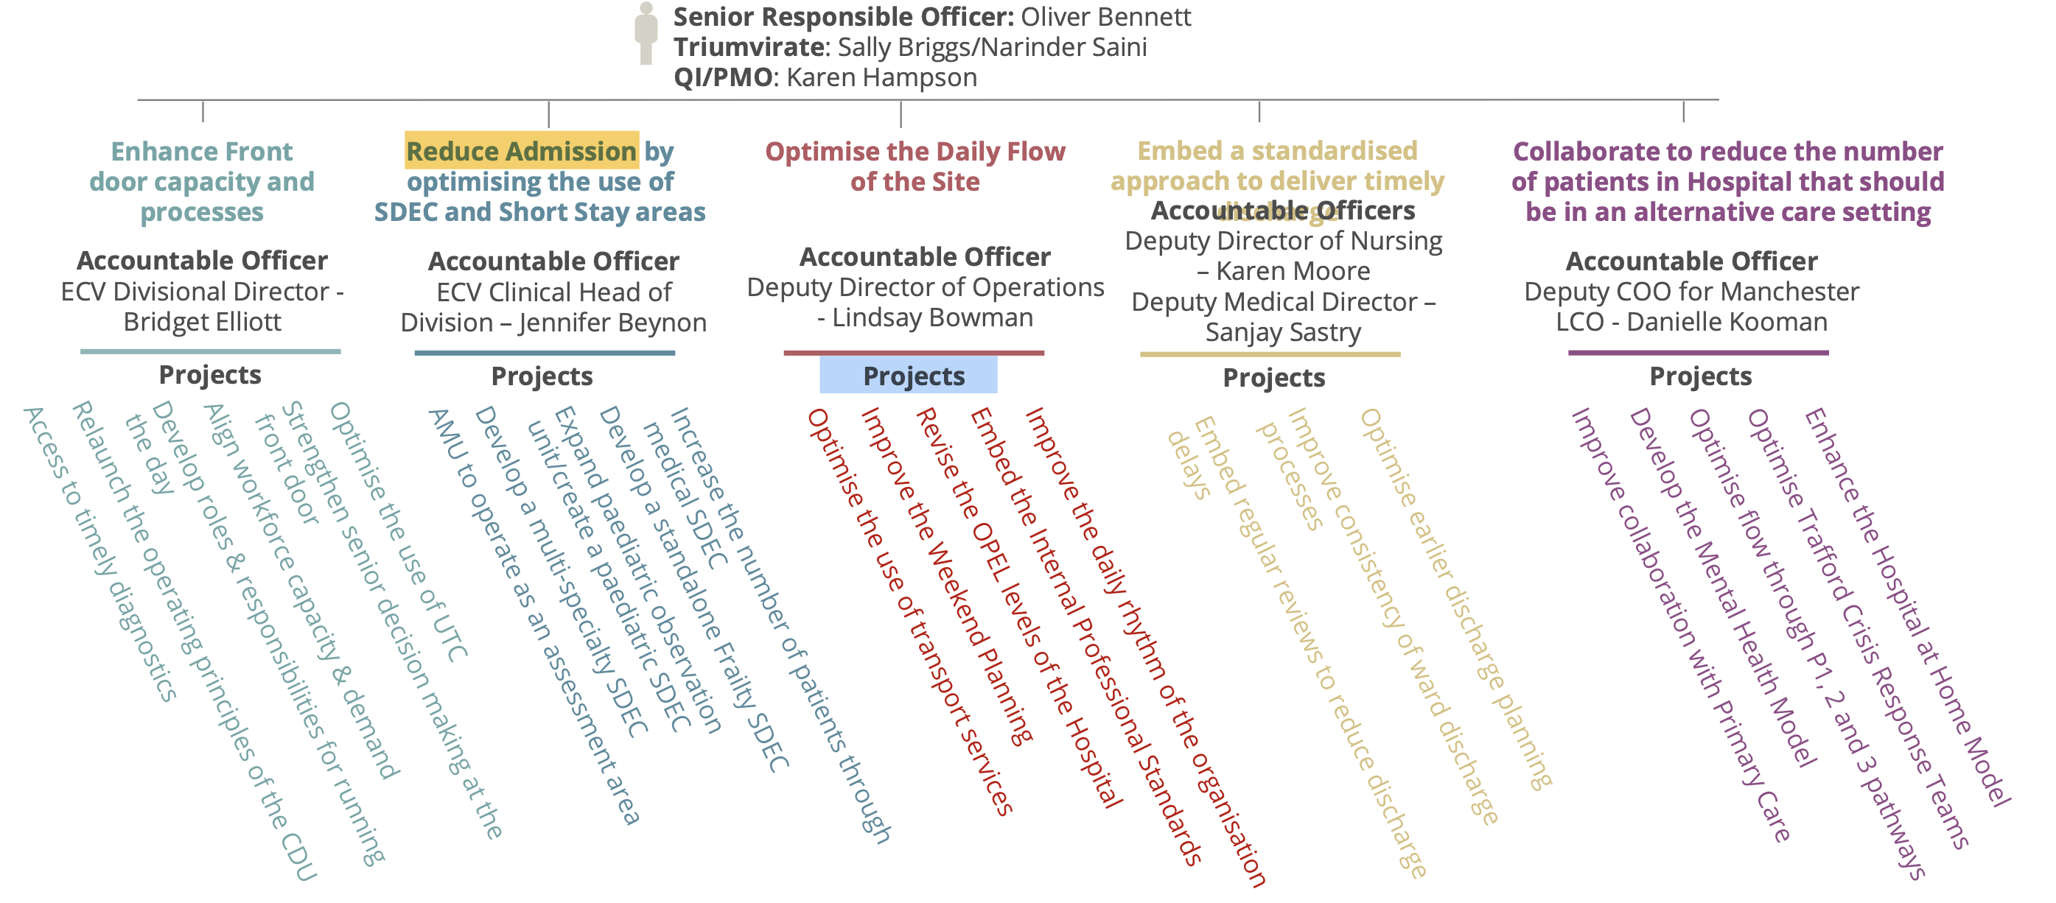
Solutions
Notes:
• Welcome and Objectives:
• Explain the purpose: to enhance understanding of observational study designs, diagnostic accuracy, and risk prediction models.
• Outline key takeaways: how to critically appraise studies and apply evidence in clinical practice.
• Why it Matters:
• The role of observational studies in generating real-world evidence.
• Importance in informing clinical decision-making without the constraints of randomized controlled trials (RCTs).

Slide 5
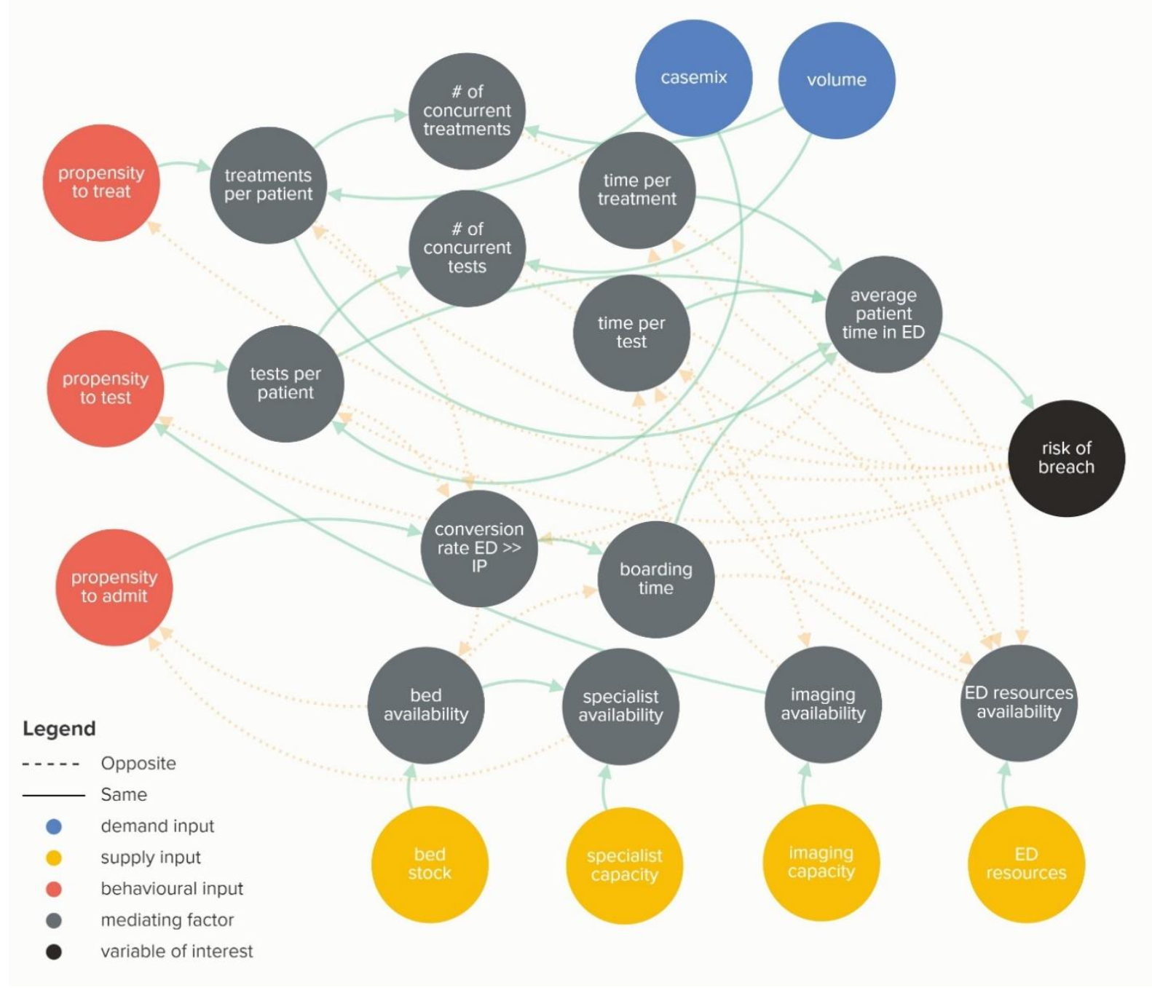
Acute care a complex adaptive system

Slide 6
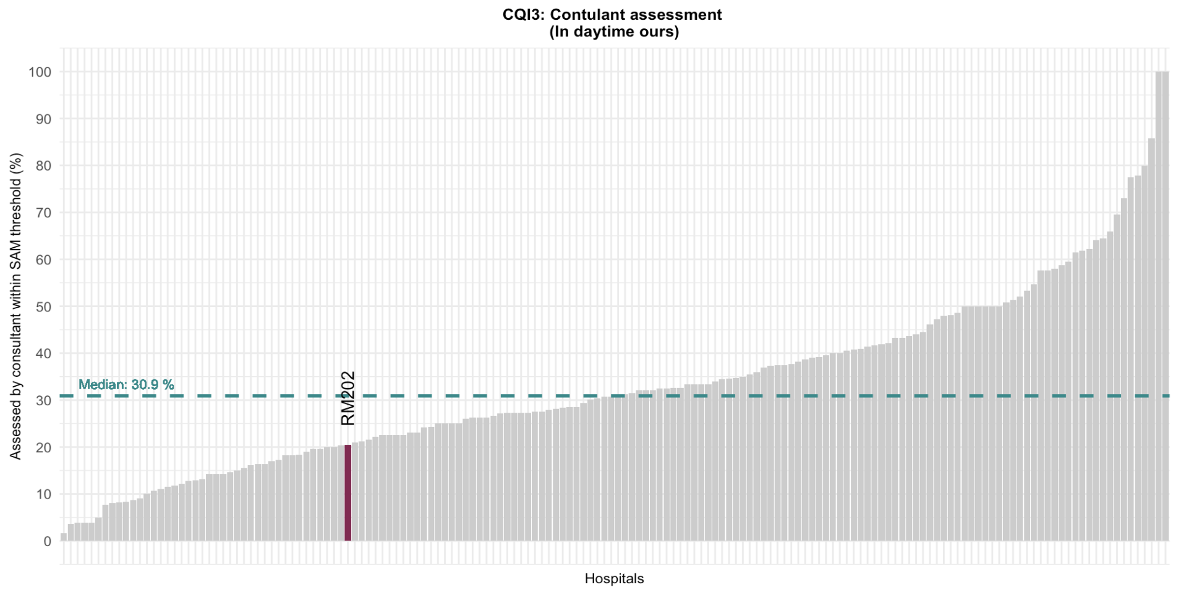
Wythenshawe: National Benchmarking
Consultant assessment within 6 hours of arrival
(07:59-20:00)
*SAMBA24: single day of care survey

Slide 7
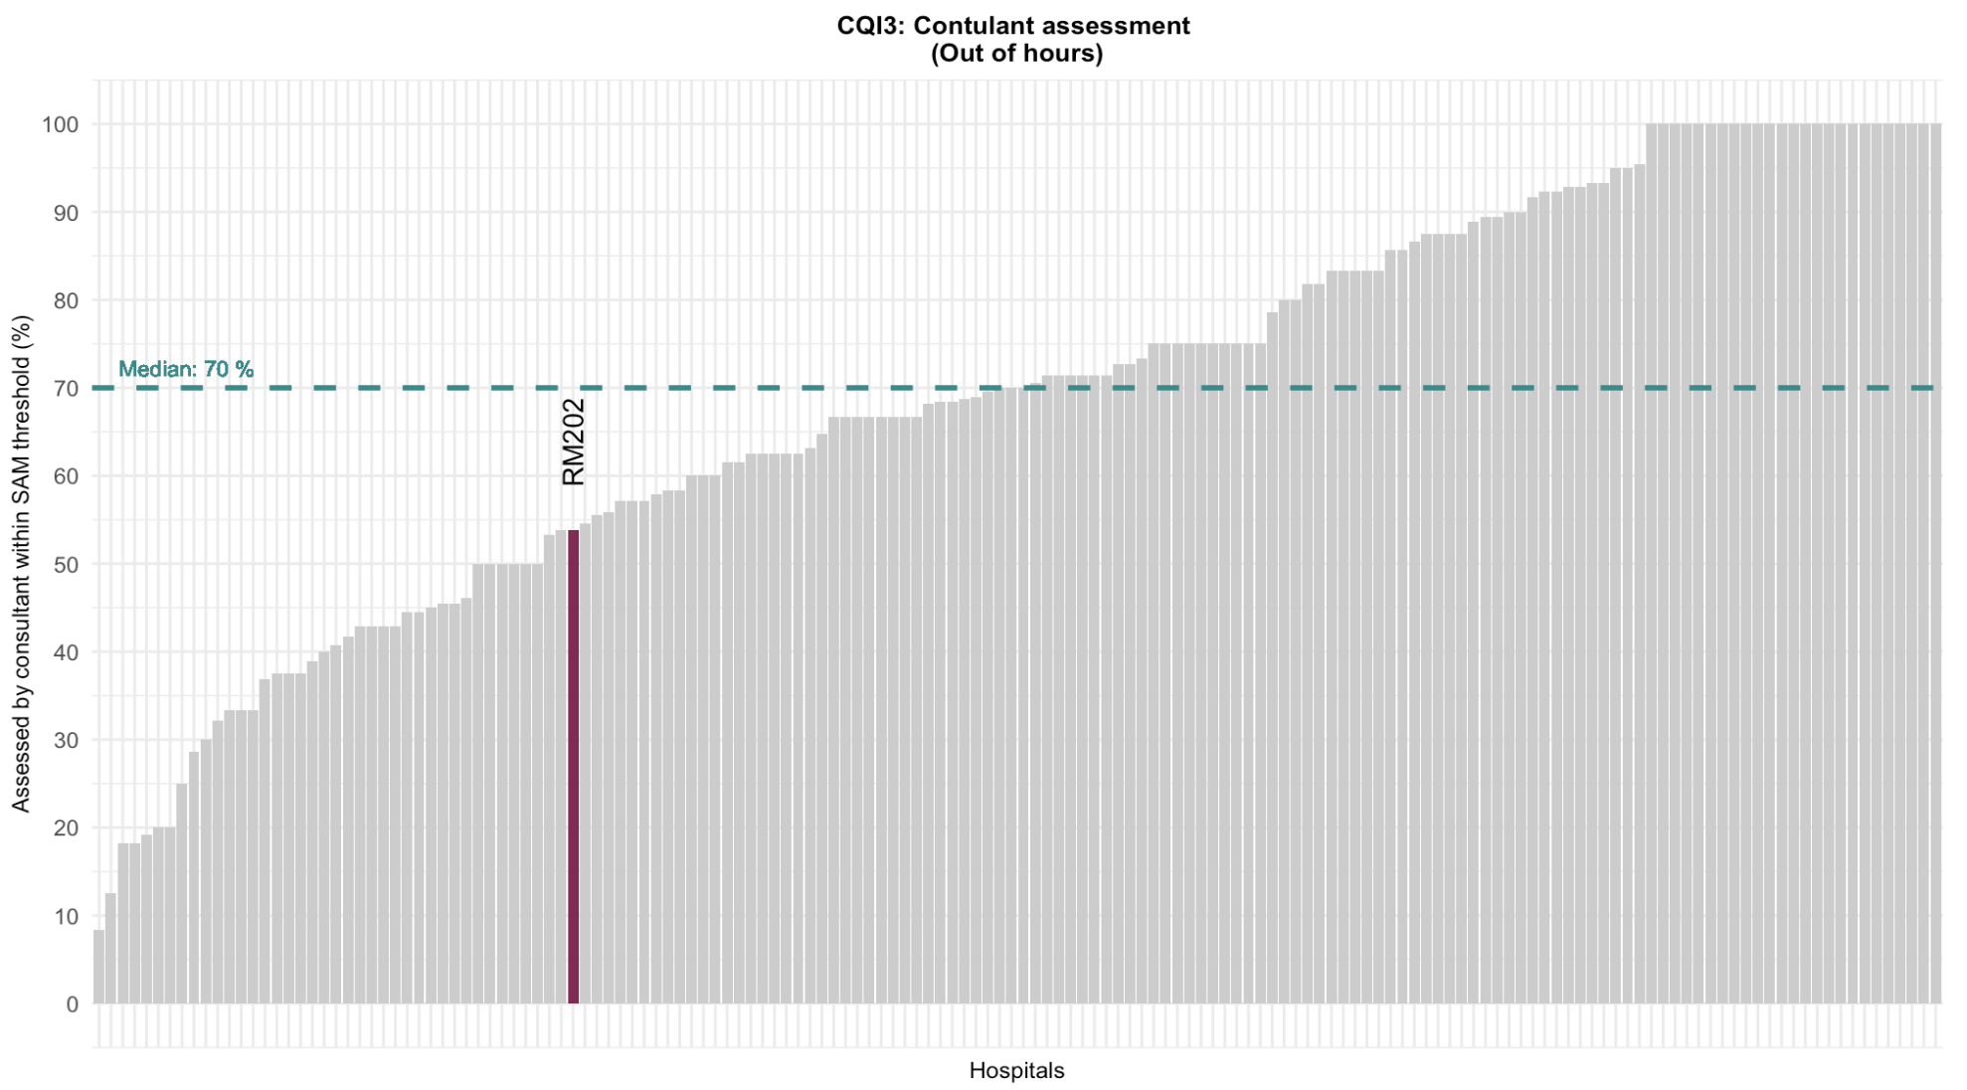
Wythenshawe: National Benchmarking
Consultant assessment within 14 hours of arrival
(20:00-07:59)
*SAMBA24: single day of care survey

Slide 8
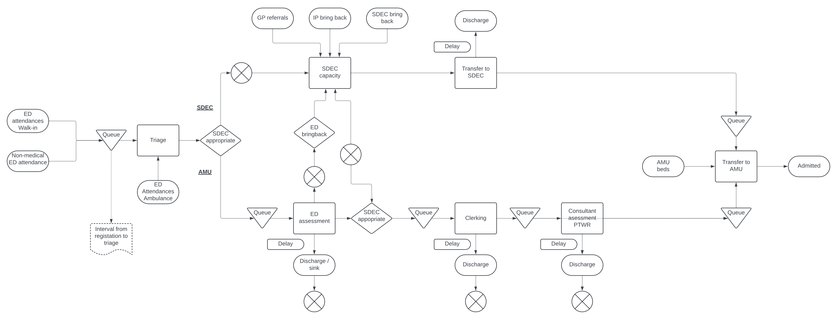
Process map: Acute Medicine Activity in ED

Slide 9
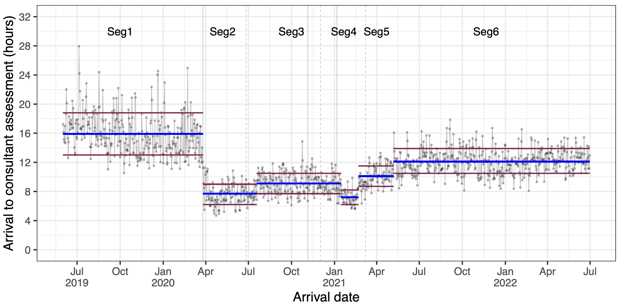
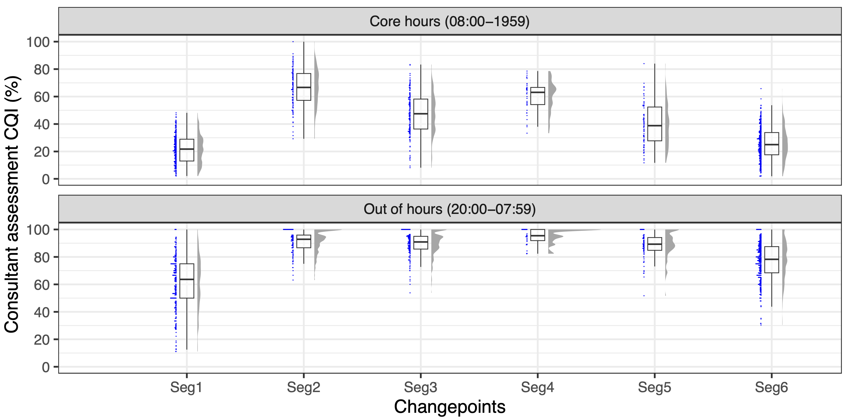
ED as a defacto AMU

Slide 10
A data driven acute medicine pathway
WP1: Discrete event simulation
Technique for analysing complex systems
Models flow based on care processes
Focus on resources
Identifies bottle necks
“What if” analysis
WP2: Defining patient subpopulations
ML techniques
Identify patient subpopulations of patients
Tailored service provision
High impact interventions
WP3: Defining patient subpopulations
Implement new technology
Point of care diagnostics
Wearable
EPIC workflow

Slide 11
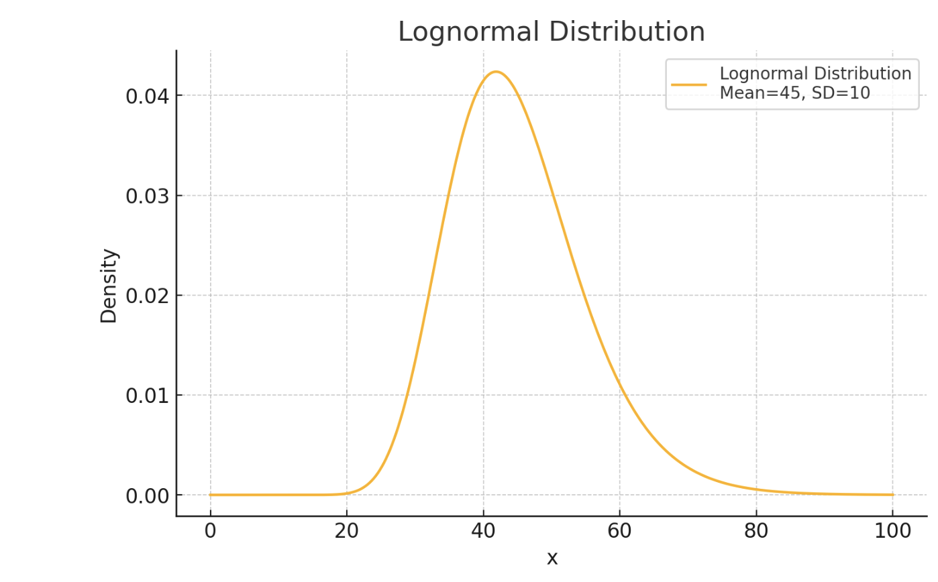
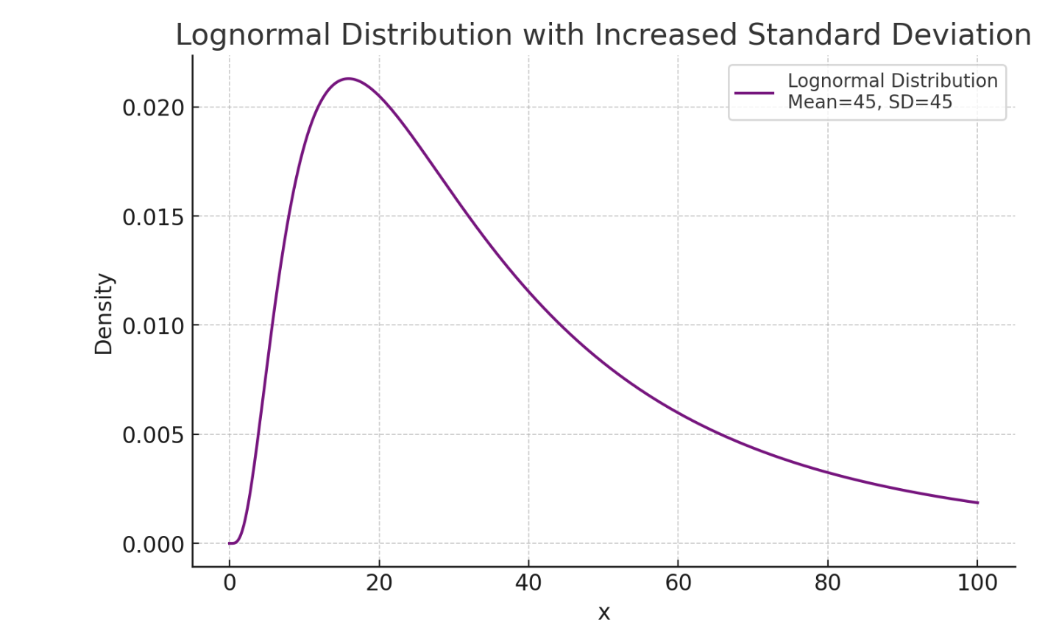
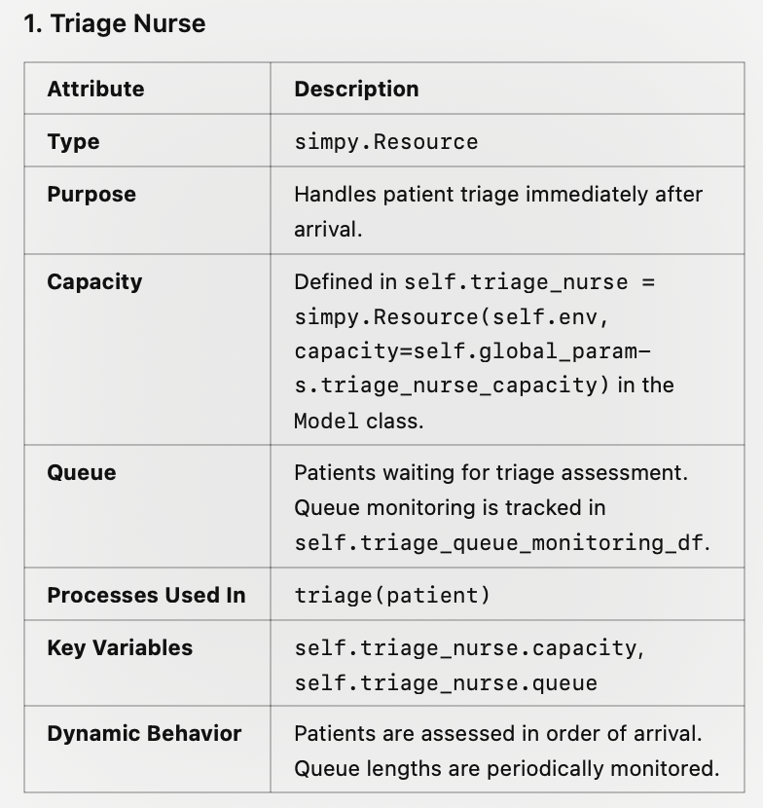
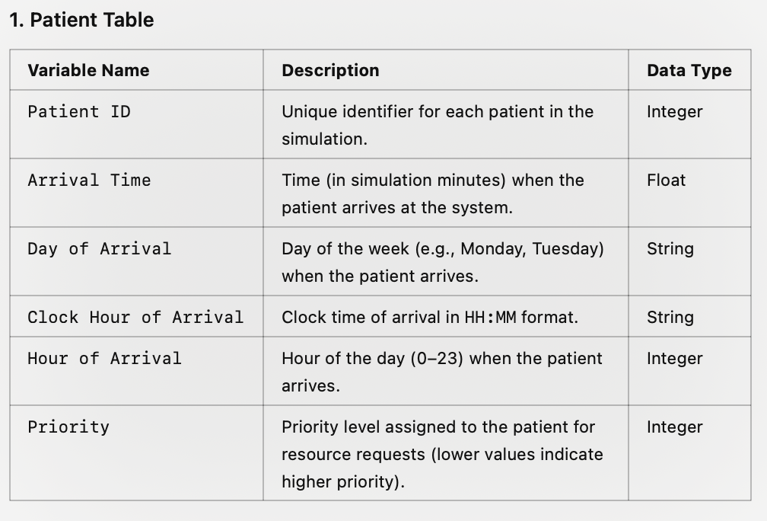
Discrete event simulation: intuition

Slide 12
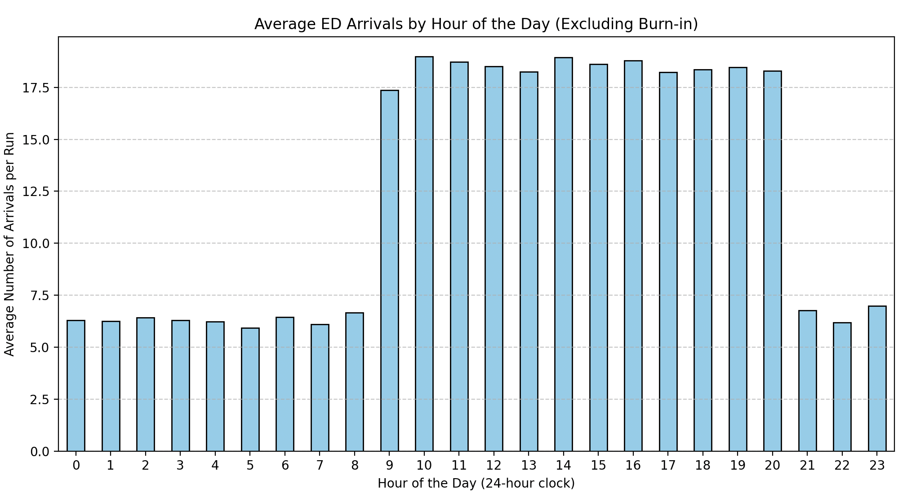
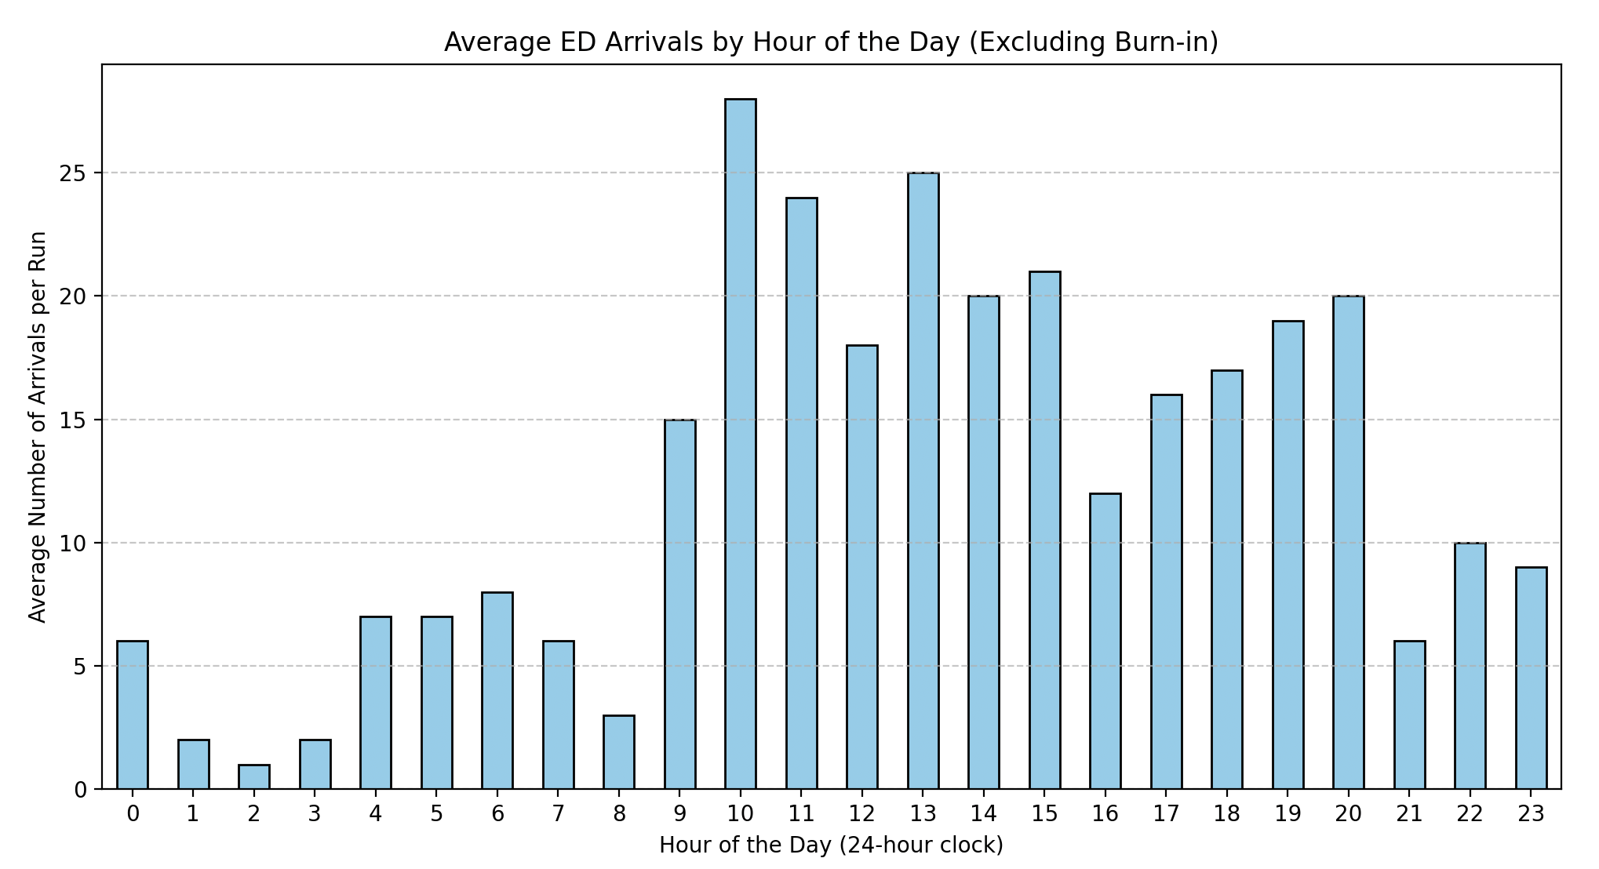
Discrete event simulation: probabilistic / thrive on variability
Average ED attendance over 365 days
A single days Attendance

Slide 13
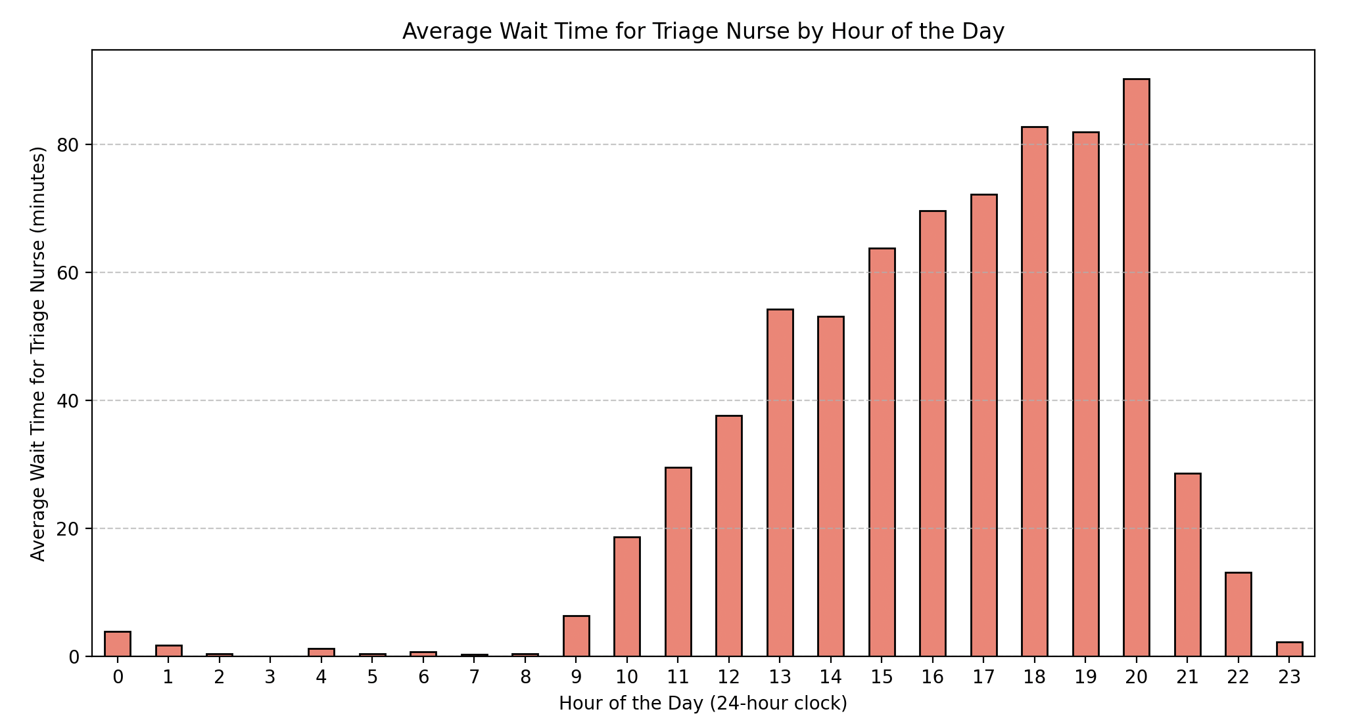
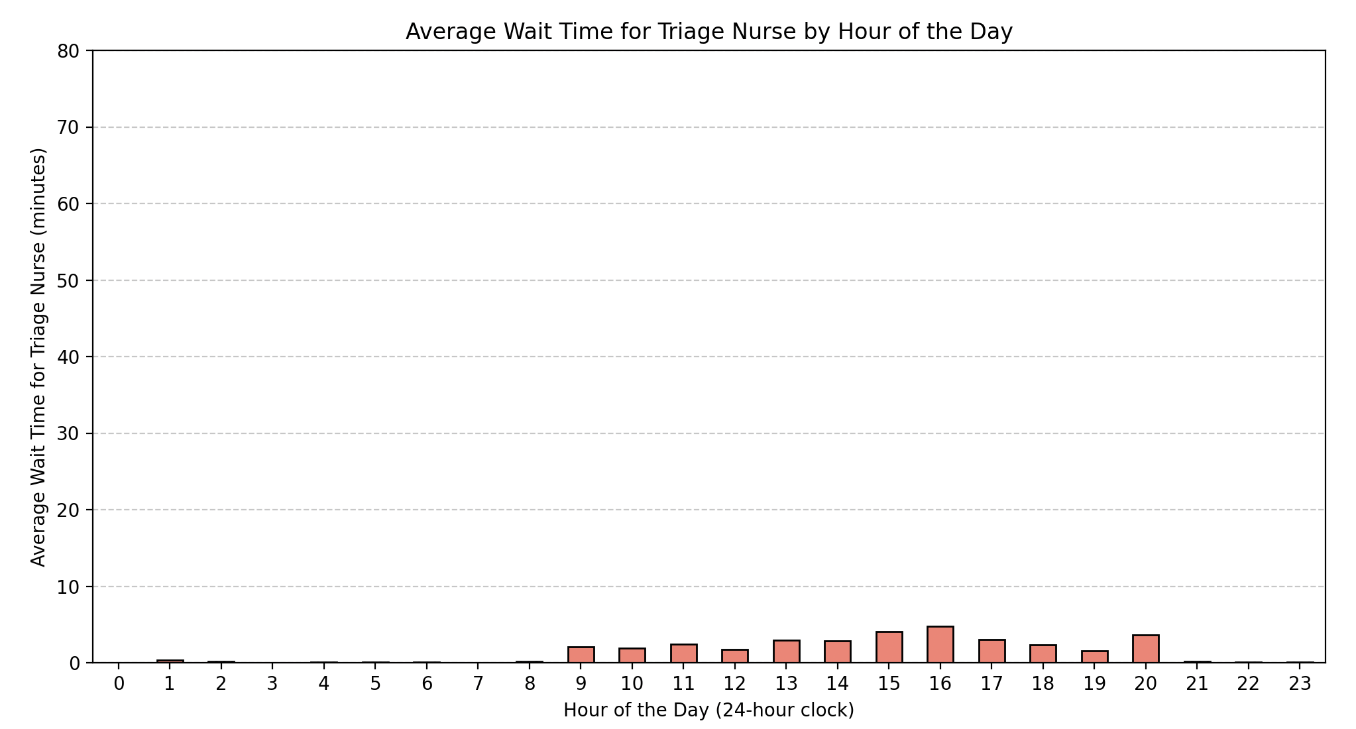
Discrete event simulation: what if analysis
Triage nurse capacity = 2
Triage nurse capacity = 3

Slide 14
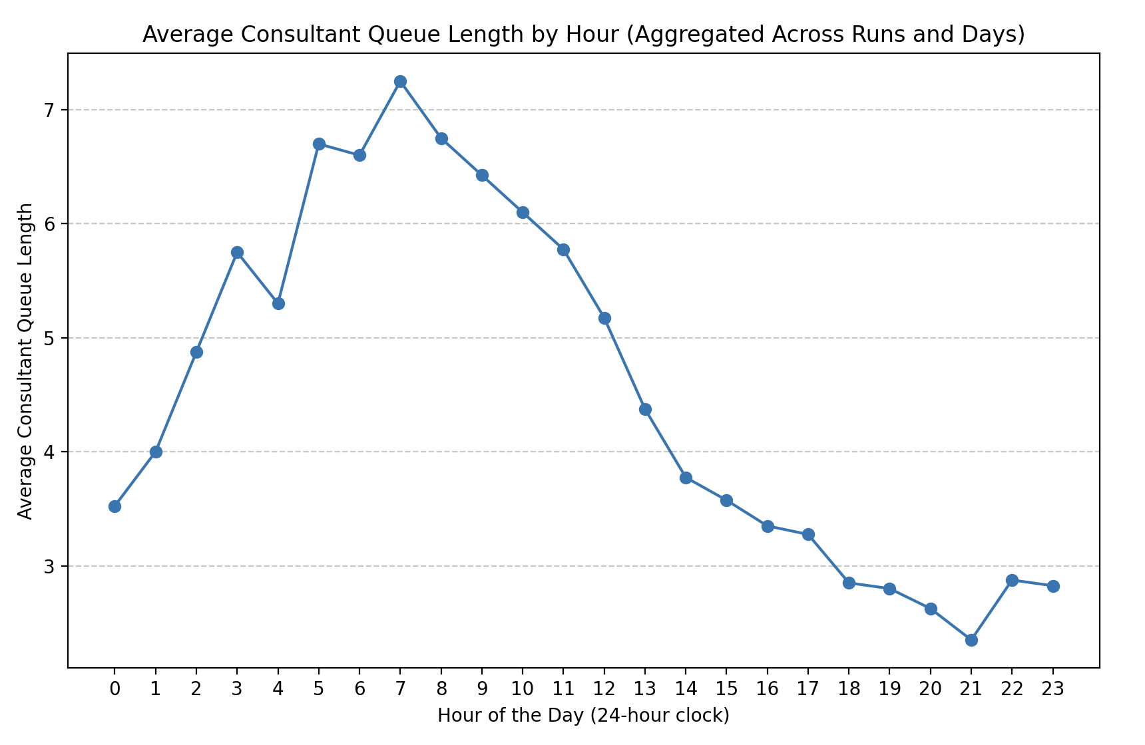
Discrete event simulation: PTWR in ED
Consultants 07:00-21:00 = 2
AMU bed rate = 1 per hour

Slide 15
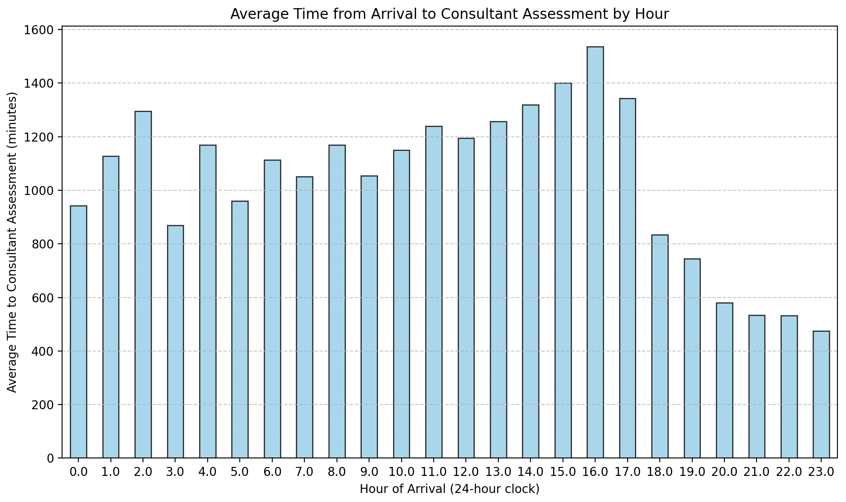
Discrete event simulation:
Consultants 07:00-21:00 = 10
AMU bed rate = 1 per hour

Slide 16
Future work
Validate model
Build at Wythenshawe – emulate across trust sites
Suggestions for “what if” scenarios
Add additional complexity
Access to diagnostics
Treatments
Geographical / Estate (beds as rource)
Current limiting step
Access to data
Notes:
• Welcome and Objectives:
• Explain the purpose: to enhance understanding of observational study designs, diagnostic accuracy, and risk prediction models.
• Outline key takeaways: how to critically appraise studies and apply evidence in clinical practice.
• Why it Matters:
• The role of observational studies in generating real-world evidence.
• Importance in informing clinical decision-making without the constraints of randomized controlled trials (RCTs).

Slide 17
Thanks:

